Slide 1
COMPARISON OF FUEL ECONOMY FOR TOYOTA AND HONDA VEHICLES.
BY
Eric Agyemang
MAT 450

Slide 2
Outline
Problem Background
Purpose of Project
Methods
Results
Conclusion and Recommendation

Slide 3
Background
Fuel economy of vehicles driven in the United States (US) is often measured in miles per gallon (MPG).
Fuel economy may be viewed in two distinct ways:
Expected mileage the vehicle can travel on a highway setting
Expected mileage the vehicle can travel within a city environment
Toyota and Honda, two popular Japanese automobile makes

Slide 4
Purpose of Project
To determine which of the two companies Honda and Toyota manufacture the vehicle with the better, overall city and highway fuel economy.
To determine which company manufacture the vehicle with the better city and highway fuel economy based upon individual classes.
Help buyer make the best choice amount the two makes

Slide 5
Methods
Data on Toyota and Honda (2014-2018) collected from Kaggle.com
Class
City mpg
Highway mpg
Sampling Techniques:
SRS
Stratified Sampling

Slide 6
Methods Cont..
Use R and SAS for the analysis
Kernel Density Estimation
Used to show the distribution of City and Highway mpg of the dataset.
SAMPLE SIZE ESTIMATION
Sample size of Toyota and Honda population – (sample.size.mean choosing a margin of error of 0.1 with population of Honda 49662 and population of Toyota 49127 and alpha level of 0. 05).

Slide 7
Methods Cont…
Stratified Sampling Method
Assume: Equal amount of cost of measuring a vehicle for a
sample .
Design Strata using vehicle class (Neyman Allocation to Strata) Eg: Compact Cars, sport Utility Cars, Standard Utility cars 4WD are some of the strata used etc.
Relative Gain from Stratification and the Design effect.

Slide 8
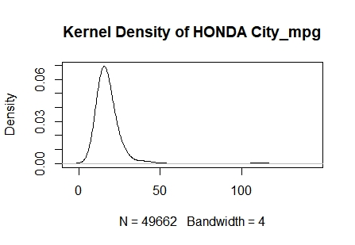
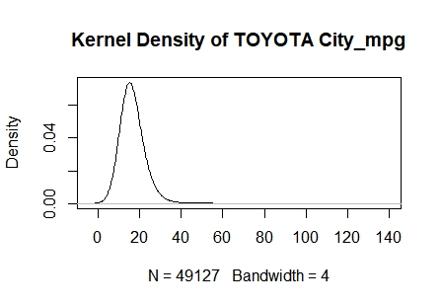
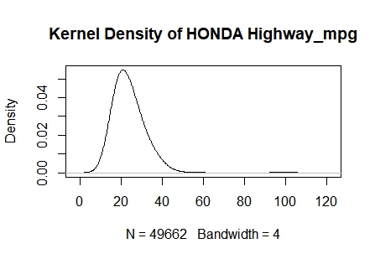
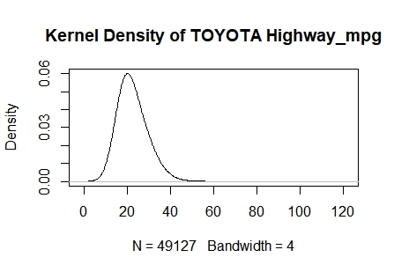
RESULTS: KERNEL DENSITY ESTIMATION

Slide 9
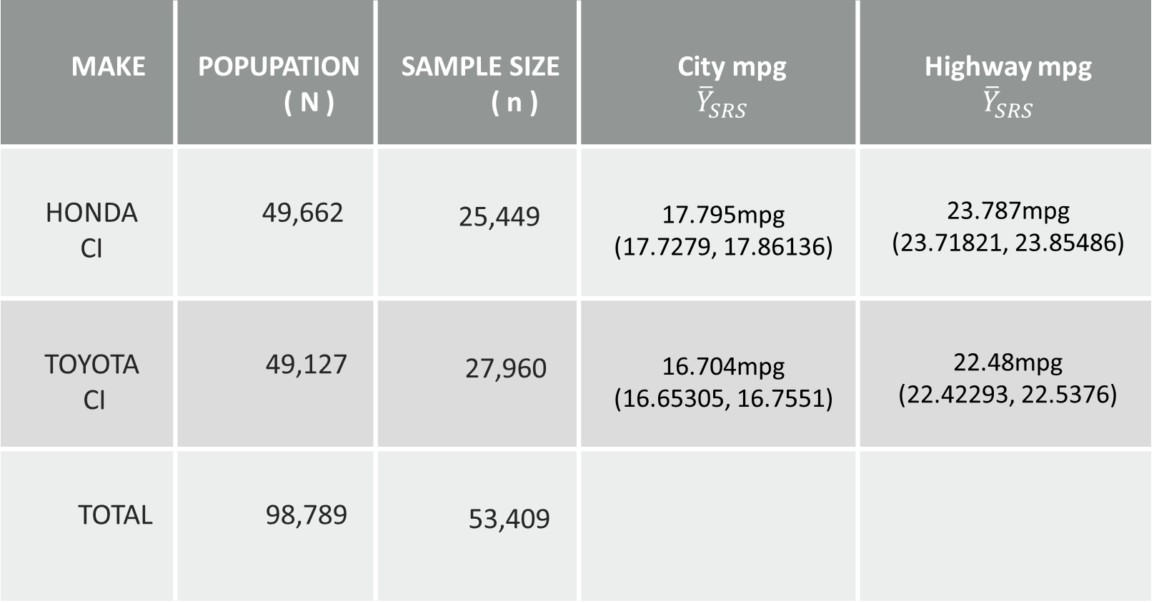
RESULT Cont.. SRS
MAKE | POPUPATION ( N ) | SAMPLE SIZE ( n ) | City mpg $${\overline{Y}}_{SRS}$$ | Highway mpg $${\overline{Y}}_{SRS}$$
HONDA CI | 49,662 | 25,449 | 17.795mpg (17.7279, 17.86136) | 23.787mpg (23.71821, 23.85486)
TOYOTA CI | 49,127 | 27,960 | 16.704mpg (16.65305, 16.7551) | 22.48mpg (22.42293, 22.5376)
TOTAL | 98,789 | 53,409

Slide 10
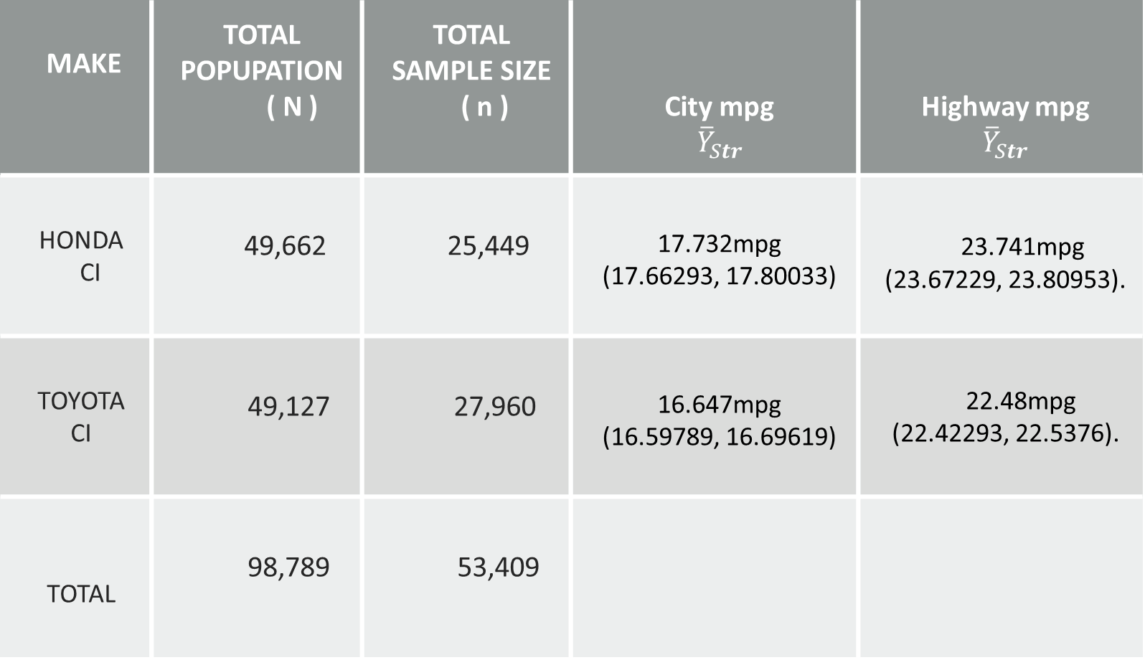
RESULT Cont.. Stratified Sampling
MAKE | TOTAL POPUPATION ( N ) | TOTAL SAMPLE SIZE ( n ) | City mpg $${\overline{Y}}_{Str}$$ | Highway mpg $${\overline{Y}}_{Str}$$
HONDA CI | 49,662 | 25,449 | 17.732mpg (17.66293, 17.80033) | 23.741mpg (23.67229, 23.80953).
TOYOTA CI | 49,127 | 27,960 | 16.647mpg (16.59789, 16.69619) | 22.48mpg (22.42293, 22.5376).
TOTAL | 98,789 | 53,409

Slide 11
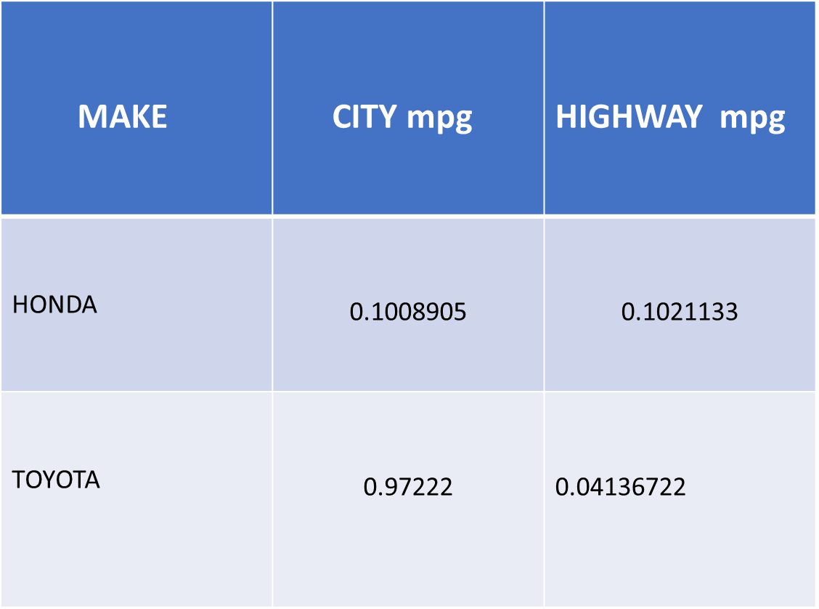
Results Cont.. Gain from Stratification
Gain from Stratification
MAKE | CITY mpg | HIGHWAY mpg
HONDA | $$\text{0.1008905}$$ | $$\text{0.1021133}$$
TOYOTA | $$\text{0.97222}$$ | 0.04136722

Slide 12
Conclusion and Recommendation
Both techniques express the same type of results.
Buying a Honda vehicle would be the better option.
Buyer should buy Honda vehicles to minimize cost.

Slide 13
THANK YOU!

